Slide 1
Exploring Popularity of Etsy Listings
By Kelly Zhao

Slide 2
Project Goal
Gain an understanding of interesting relationships between features of a listing on Etsy, including what might make a post popular
This could help shop owners create listings that will get the most views and favorites, eventually leading to purchase funnel conversions and increased revenue

Slide 3
Initial Questions
Which are the different product categories and their distribution?
What are some characteristics of the most popular listings?
Does creating the listing at a certain time of year lead to more views or favorites?
Notes:
Initial questions I had related to popularity are

Slide 4
Data Pipeline
Data Source: Etsy API
Pulled data from Active Listings collection, and Seller taxonomy to identify correct product categories
Data Cleaning
Dropped duplicates, nulls → 61231 rows total, each a unique listing on Etsy
Feature Engineering
Title, description, tags length; converted timestamps

Slide 5
Measure of Popularity
Using ‘views’ and ‘num_favorers’ columns
Since the distributions for views and favorites appear to be concentrated near 0, with a heavy skew toward higher end, wanted to account for extreme cases of popularity
Used interquartile method to divide dataset into levels of popularity
Notes:
These are highly correlated, but not perfectly - ranges from 0.6 to 0.9
When testing, may lead to more views but not more favorites
A view may not always translate into a favorite, so there must be factors at play other than exposure that lead a user to favorite a listing
twice to first divide into regular and outliers, and then divide the outliers into popular and most popular

Slide 6
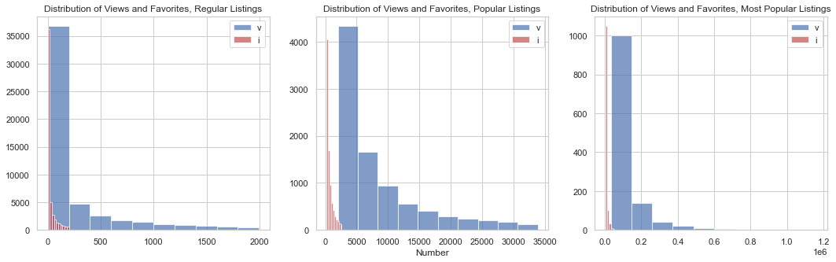
Measure of Popularity
Notes:
Even after dividing the dataframe, data is heavily skewed, indicating very few posts reach

Slide 7
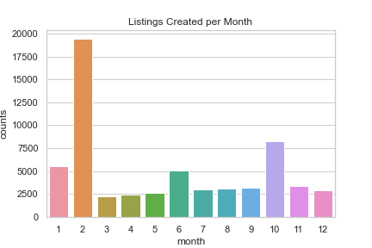
Seasonality in Post Creation
Notes:
To examine seasonality in post creation, I grouped listings by which month they were created in over the entire dataset. February sees a strikingly large number of posts compared to other months, which made me curious as to what might be driving this behavior

Slide 8
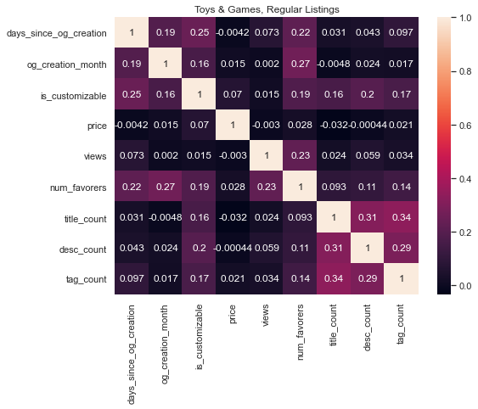
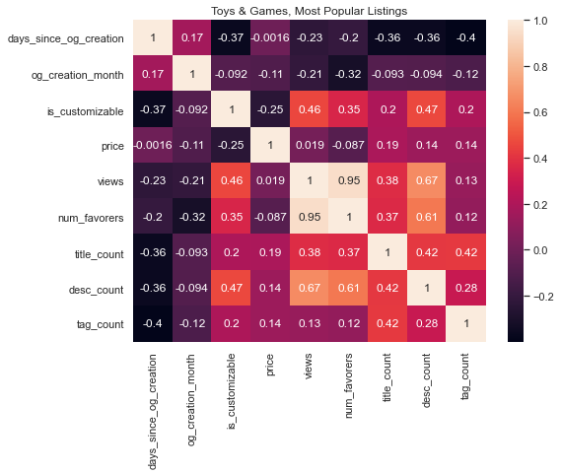
Text Length
Notes:
Can see warmer spots around the quantitative text feature columns
Could be due to smaller sample size, so wanted to test

Slide 9
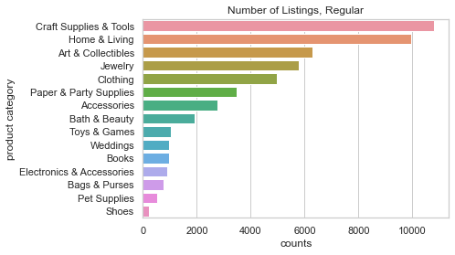
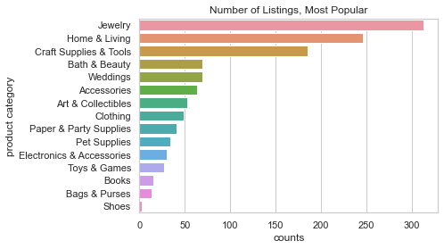
Product Categories
Notes:
Once I finished cleaning the data and creating new features, I was able to gain some insight into the data, the first being the distribution of product categories
These are 15 different top-level product categories and their sample counts
For regular and Popular posts, Craft Supplies & Tools is the most common category
For most popular posts, Jewelry is the most common category, and Craft Supplies & Tools is third
Is the difference between proportion of most popular Jewelry posts and most popular Home & Living posts significant?

Slide 10
Hypothesis Testing
Null Hypothesis 1: Creating a listing in February does not lead to more views/favorites vs. other months
Null Hypothesis 2: The most popular listings do not have longer titles than popular listings
Null Hypothesis 3: Jewelry listings have the same proportion of popular listings compared to Home & Living
Notes:
Assumptions:
IID
Equal variance
Set alpha = 0.05
H1:
H2:
H3: home & living product category with second highest number of popular listings

Slide 11
Hypothesis 1
Creating a listing in February does not lead to more views/favorites vs. other months
 | Views p-value | Favorites p-value
Regular | 0.0 | 1.019e -291
Popular | 0.619 | 0.054
Most popular | 0.735 | 0.94
Result: Reject
Notes:
The result is much more significant for favorites than for views. Furthermore, the test did not hold for listings that are already popular

Slide 12
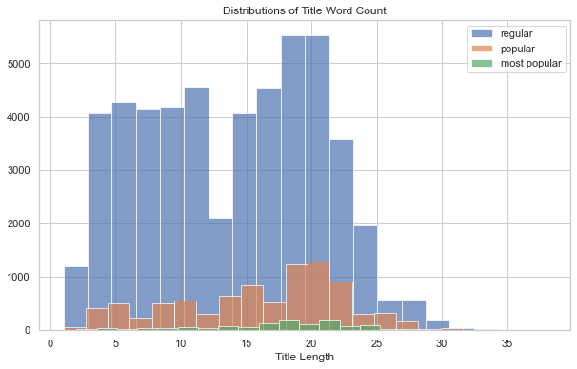
Hypothesis 2
The most popular listings do not have longer titles than popular listings
Two-sample t-test
P-value: 3.206e -17
Result: Reject
 | Regular | Popular | Most Popular
Mean of Title Length | 13.81 | 15.98 | 17.52
Notes:
Equal variances = False
Shown for views, also significant for favorites

Slide 13
Hypothesis 3
Jewelry listings have the same proportion of popular listings compared to Home & Living
Observed | Regular | Popular | Most Popular
Jewelry | 5764 | 1103 | 313
Home & Living | 9943 | 1487 | 246
Chi-square contingency test
P-value: 7.407e -25
Result: Reject
Expected | Regular | Popular | Most Popular
Jewelry | 5980.92 | 986.22 | 212.86
Home & Living | 9726.08 | 1603.78 | 346.14
Notes:
Generated a contingency table for both product categories for each level of popularity
The chi-square contingency test tests for independence of the observed frequencies in the contingency table

Slide 14
Key Takeaways
Most listings on Etsy could benefit from being created in February
Longer, more descriptive titles are positively correlated with popularity
A disproportionate amount of popular listings are in Jewelry
Could either mean a post is more likely to become popular in Jewelry, or there are already many competing posts
https://github.com/kellybean19/Exploring-Etsy-Listing-Features
Notes:
For listings that are popular, the month of creation does not seem to make a difference (there are likely many other factors that caused them to become popular, and whether the listings was created in February is not a significant one)

Slide 15
Potential Next Steps
Examining the content within titles, descriptions, tags etc. using NLP to see if there are any specific keywords that popular listings have in common
Working with image data - images likely play a large role in influencing listing popularity → purchase decisions
Predicting whether a post will be popular or not based on its features

Slide 16
Questions?

Slide 17
Appendix

Slide 18
Data Extraction
Data Source: Etsy API
Pulled data from Active Listings collection
Also pulled their Seller taxonomy to identify correct product categories

Slide 19
Cleaning Pipeline
Created several separate dataframes
Concatenate
Drop duplicates and nulls
61231 rows total, each a unique listing on Etsy
Create first level taxonomy to compare against the first item in the taxonomy_path column

Slide 20
Feature Engineering
Created new columns for quantitative text features
# words in title
# words in description
# tags
Created new columns for converted timestamps
# days between when originally created and today
Month when created

